Slide 1
SURE TRUST Facial Emoji Recommendation system USING FACIAL EXPRESSION RECOGNITION
CHIGURUPATI VARSHA

Slide 2
Agenda
OBJECTIVE
DATASETS EXPLORED
FINAL DATASET
WORKFLOW
CHALLENGES FACED
CONCLUSION

Slide 3
Objective:
To develop a deep learning model that can detect and classify human emotions
from facial images.
Based on the recognized emotion, it will be recommending corresponding emojis
(e.g., happy face emoji for happy emotion etc).
Dataset Used:
Face Expression Recognition Dataset from Kaggle.
Contains facial images labeled with different emotions – 7 classes
(e.g., angry, happy, sad, surprise)

Slide 4
Datasets Explored
1. FER 2013 Dataset
Train Shape: (28709, 48, 48, 1)
Test Shape: (7178, 48, 48, 1)
Challenges:
High Class Imbalance.
Low Image Quality.
Models used | Epochs | Accuracy
Custom CNN | 30 | 55%
Transfer Learning VGG16 | 40 | 59%

Slide 5
2. Face-Expression-Recognition-Dataset
Train: 28,821 images, Test: 7,066 images.
3. CK+ Dataset (Extended Cohn-Kanade)
Kaggle version: around 920 images only.
4. Facial Emotion Recognition Dataset + FER (Manual)
Train: 63,000+ images (after augmentation).

Slide 6
Combined Dataset: FER 2013 + Facial Emotion Recognition
Combined datasets and Balanced them.
Applied Data Augmentation → Total images: 63,000+.
Custom CNN on this data
Tried Transfer Learning (e.g., ResNet, VGG16):
Kernel kept dying due to memory issues.
Tried on Google Colab also, but faced Runtime Disconnected problem.

Slide 7
Final Dataset – Face-expression-recognition-dataset (Kaggle)
Data Overview
Number of Images:
Total training images: 28,821
Total validation images: 7,066
Classes in the Dataset:
Angry, Disgust, Fear, Happy, Neutral, Sad, Surprise

Slide 8
Workflow of the Project
Data loading
Data augumentation
Data Preprocessing
EDA
Model Building and Training
Deploying throughStreamlit

Slide 9
Data loading
Total training images: 28821
Total validation images: 7066
Count per each class
angry: 3993 images
disgust: 436 images
fear: 4103 images
happy: 7164 images
neutral: 4982 images
sad: 4938 images
surprise: 3205 images

Slide 10
Data Preprocessing
Image Augmentation:
Applied transformations like rotation, shifting, shearing, zooming, and flipping to increase data variety.
Class Distribution:Balanced the dataset by generating augmented images for underrepresented classes (e.g., "disgust").Example: Augmenting the "disgust" class with new images to reach the target count.

Slide 11
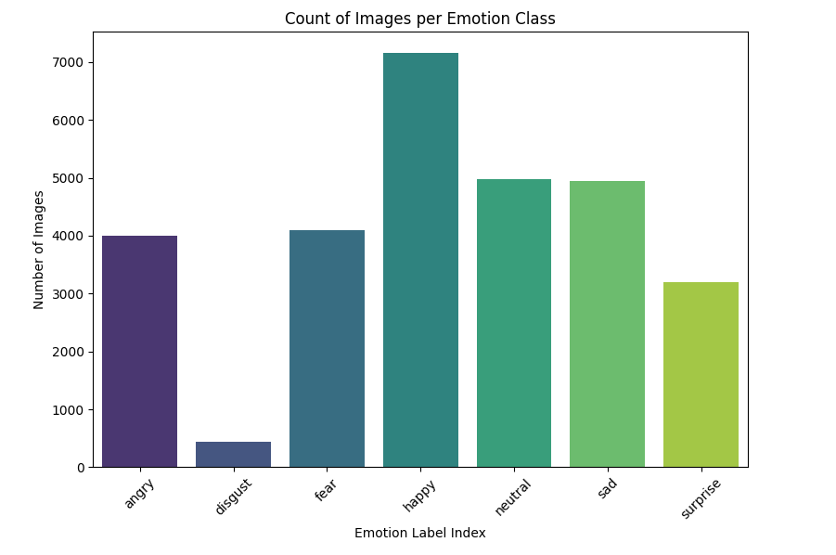
Data – count of each emotion
angry: 3993 images
disgust: 436 images
fear: 4103 images
happy: 7164 images
neutral: 4982 images
sad: 4938 images
surprise: 3205 images

Slide 12
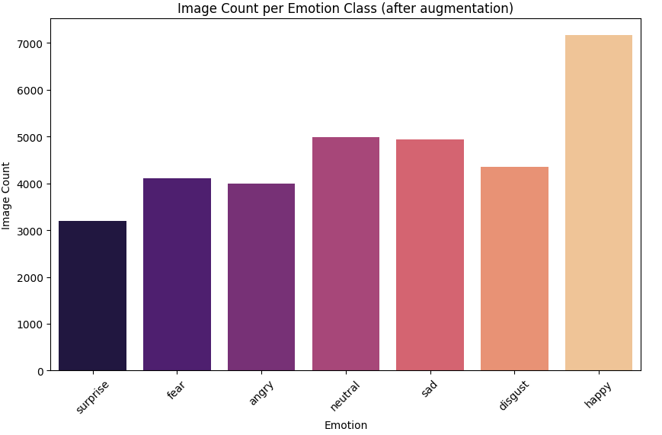
First Applied Data
Augumentation on
Disgust as it is the
lowest contributing
emotion in entire
dataset

Slide 13
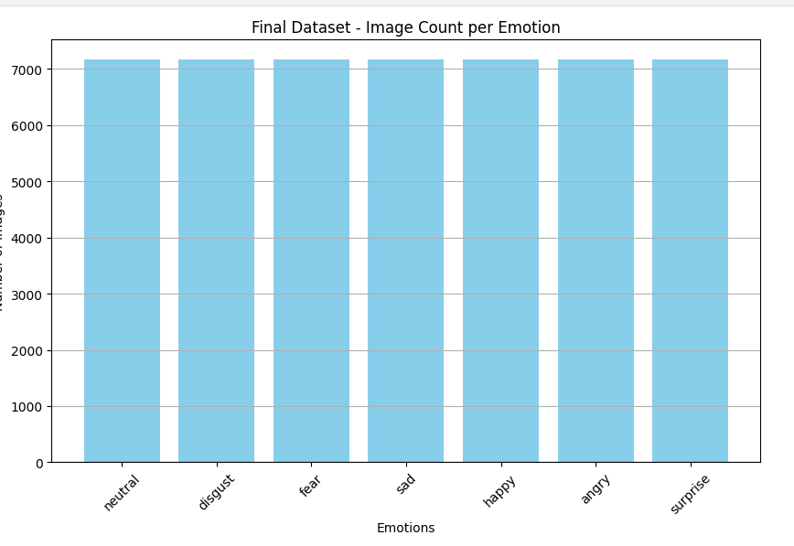
I have set a target count and augumented entire train folder (7emotions)
neutral: 7164 images
disgust: 7164 images
fear: 7164 images
sad: 7164 images
happy: 7164 images
angry: 7164 images
surprise: 7164 images
Total – 50,148

Slide 14
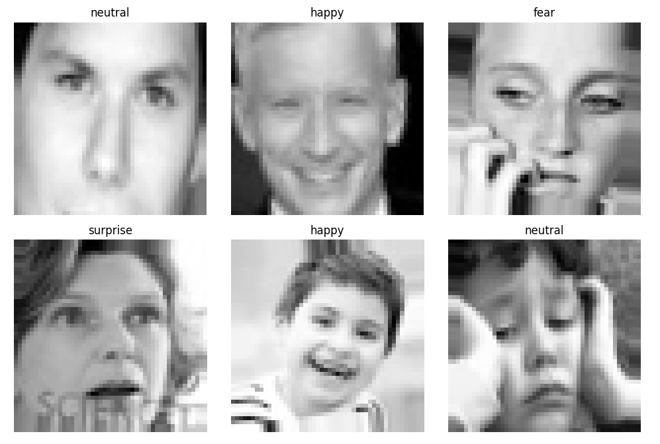
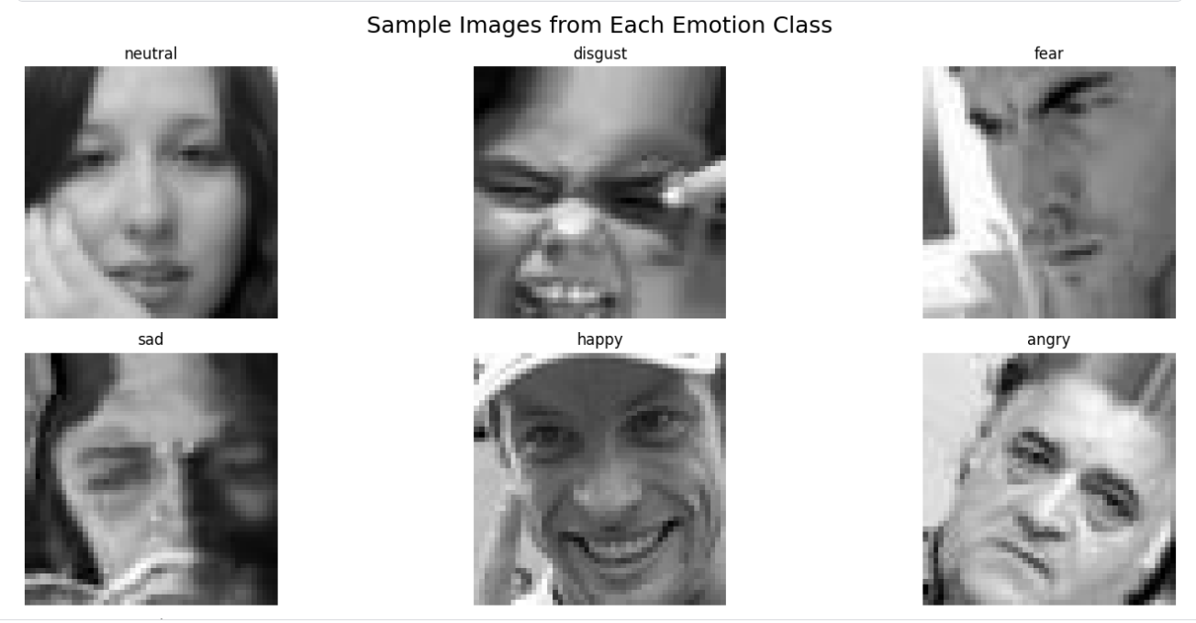

Slide 15
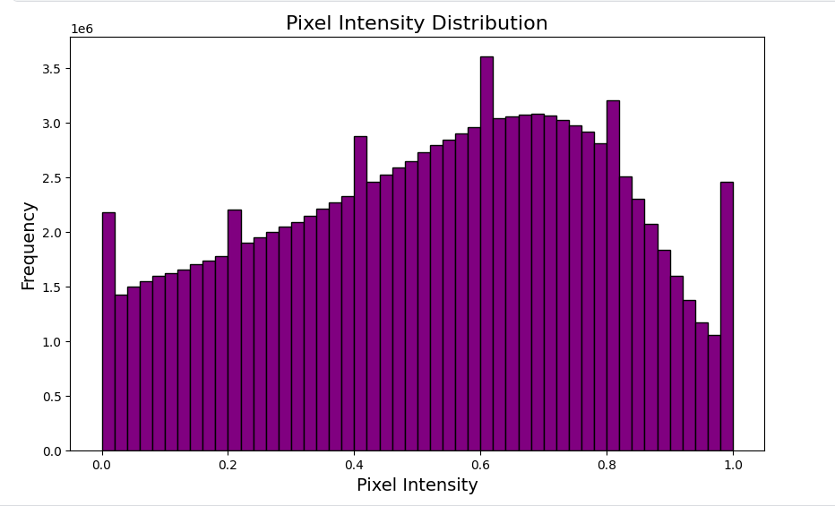
EDA
Sample images as shown in previous slide
Size of each image : Unique image sizes in dataset: {(48, 48)}
3. Pixel Distributions

Slide 16
Splitting data into Train and Validation
I have splitted the data as 80% and 20% for Train and validation
Found 40124 images belonging to 7 classes.
Found 10024 images belonging to 7 classes.

Slide 17
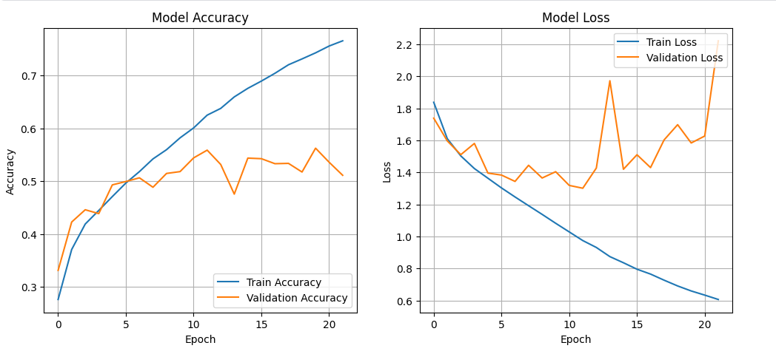
Custom CNN
Train acc : accuracy: 0.7706
val_accuracy: 0.5110
Total epochs – 50 , Early stopping – stopped at 22nd epoch.

Slide 18
Model Training
Training Setup:
Optimizer: Adam
EarlyStopping: To prevent overfitting and stop training when the validation loss plateaus.
Loss – categorical_crossentropy
Performance Metrics: Accuracy

Slide 19
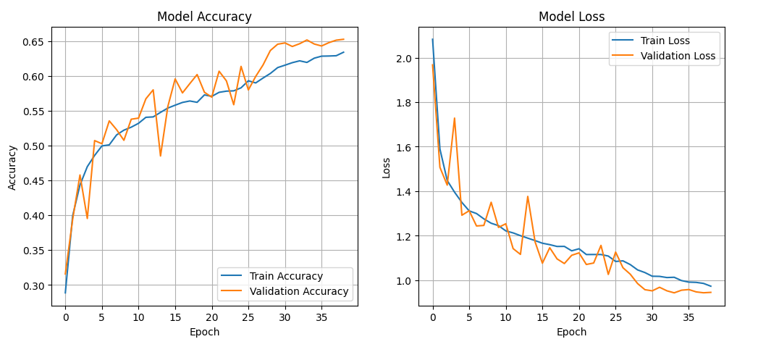
Model Used in Transfer Learning - ResNet50 Model:
Train_acc : 0.6324
val_accuracy: 0.6528
Total epochs : 50, stopped at 39th epoch

Slide 20
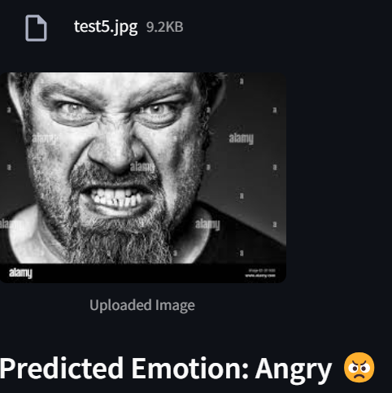
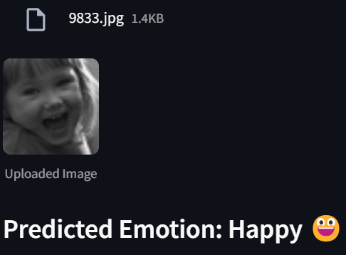
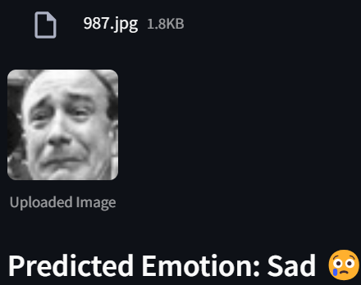
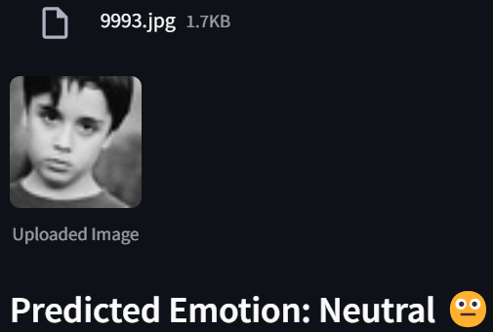
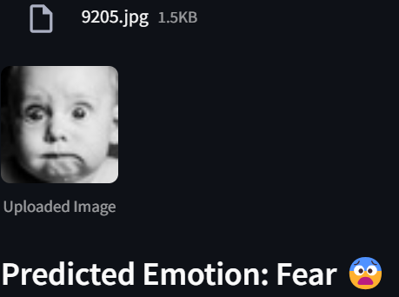
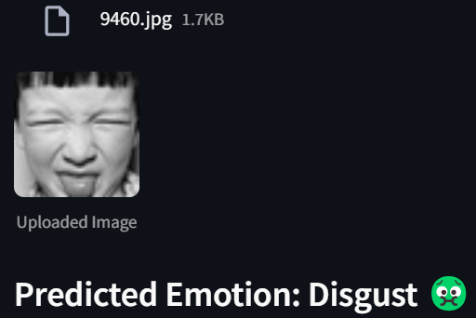

Slide 21
Challenges Faced
Imbalanced Dataset / Finding right dataset
Challenge:
Some emotions, such as "disgust" and "fear," had fewer images compared to others like "happy" and "neutral." This caused the model to perform poorly on underrepresented emotions.
Computational Constraints
Challenge:
Faced the kernel dying issues in kaggle.
Hard to differentiate between some emotions

Slide 22
Conclusion
I have successfully developed an Emoji Recommendation System using ResNet50 for facial expression recognition, achieving emotion detection from images. The model was deployed through Streamlit, allowing users to easily upload images and receive emoji suggestions based on their emotions. This project showcases the power of deep learning in creating interactive, real-time AI applications. Future improvements could include live webcam support and expanding the emoji set.

Slide 23
THANK YOU

